Slide 1
Employee Data Analysis using Excel
STUDENT NAME: L. Aswini
REGISTER NO: 122200073
DEPARTMENT: B.com(cs)
COLLEGE pachaiyappas college for women

Slide 2
PROJECT TITLE
Employee attrition analysis using excel dashoards

Slide 3


AGENDA
Problem Statement
Project Overview
End Users
Our Solution and Proposition
Dataset Description
Modelling Approach
Results and Discussion
Conclusion
3/21/2024 Annual Review

Slide 4

PROBLEM STATEMENT
Successful employees meet deadlines, make sales, and build the brand through positive customer interactions

Slide 5

PROJECT OVERVIEW
.
The Employee Attrition Analysis project aims to create an interactive Excel dashboard to analyze and visualize employee turnover data, helping organizations identify key factors contributing to attrition and make data-driven decisions to reduce it.

Slide 6

WHO ARE THE END USERS?
Easily exploring attrition data Identifying trends and patterns Making data-driven decisions Tracking the effectiveness of retention initiatives Gaining insights to improve employee experience and engagement

Slide 7

OUR SOLUTION AND ITS VALUE PROPOSITION
Our solution, "Attrition Insights," is an interactive Excel dashboard that empowers organizations to analyze and understand employee attrition trends, identify key drivers, and make data-driven decisions to reduce turnover

Slide 8
Dataset Description
This data set contains employee-level information for a large organization, including demographic details, job information, and attrition status.

Slide 9

THE "WOW" IN OUR SOLUTION
The Predictive Attrition Risk Score provides a game-changing insight into employee turnover, enabling organizations to anticipate and prevent attrition. This proactive approach sets our solution apart, making it a must-have for HR and business leaders seeking to optimize talent management and reduce turnover costs.
3/21/2024 Annual Review
9

Slide 10
MODELLING
By using this modeling approach, the Excel dashboard will provide a comprehensive analysis of employee attrition, enabling organizations to identify key drivers, predict turnover risk, and develop data-driven retention strategies.
10

Slide 11
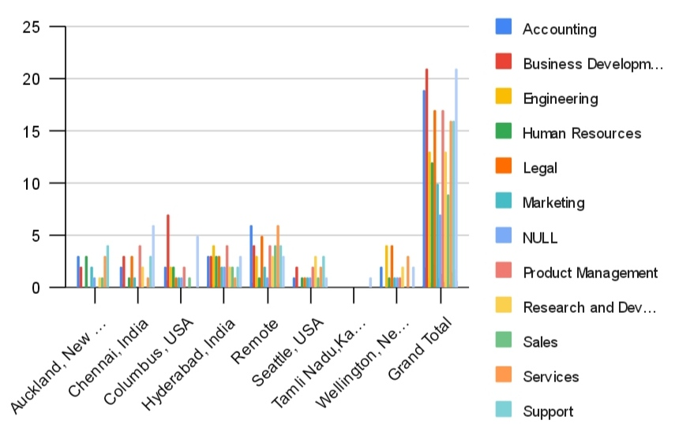
RESULTS
11

Slide 12
conclusion
The Employee Performance Analysis Using Excel project provides a robust and user-friendly solution for evaluating and managing employee performance. By leveraging Excel's powerful tools-such as fitering, pivot tables, charts, and conditional formatting-the project transforms raw performance data into actionable insights. The resulting interactive dashboards and customizable reports empower managers to make data-driven decisions, optimize workforce productivity, and foster continuous improvement across the organization. This solution not only streamlines performance management but also offers a cost- effective, scalable approach to enhancing overall organizational efficiency.

